Slide 1
Funding Your
Study Abroad Experience
Paula Messina, AIFS University Relations Coordinator

Slide 2
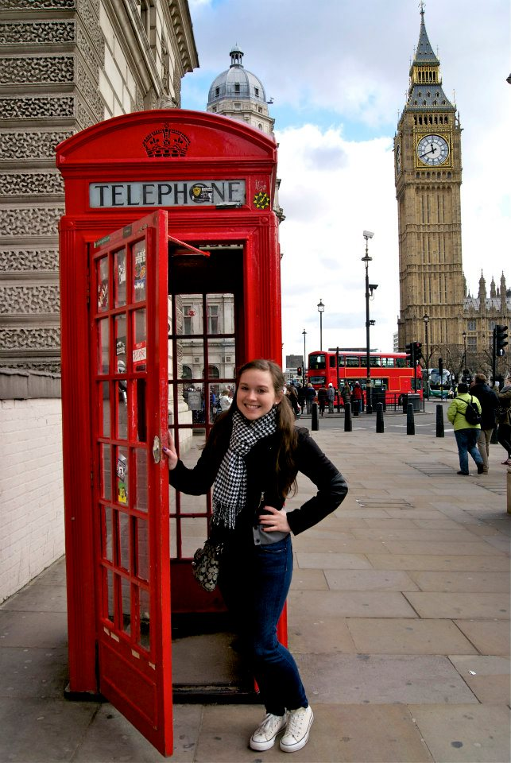
Fewer than 10%
of US college students
study abroad
Having this opportunity makes you unique from your peers.

Slide 3
Know your finances.
1. Know how much study abroad is going to cost.
How much are program fees? What is included?
How much is not included in the program fees? How much will I need for tuition, passport, extra insurance, etc?
How much will I need when I am abroad? Food, fun, independent travel?

Slide 4
Know your finances.
2. Financial Aid can be used to pay program fees
Fill out your FAFSA by the California deadline. Grants like the Pell Grant, Cal Grant and Chaffey Grant are free money and have deadlines!
Awards from the Financial Aid office may include loans:
Subsidized Loans do not have to be paid back or incur interest until you graduate with a degree.
Unsubsidized Loans or Parent Loans do have to be paid back starting immediately and will start to incur interest.

Slide 5
Scholarships = Time well spent.
Applying for scholarships should be treated like a job
Use holiday and summer breaks (when you often have more free time) to work on researching and applying
Apply early and often
Don’t discount smaller scholarships as a “waste of time”
Keep in mind that a scholarship doesn’t have to be specifically for studying abroad in order for you to use the funds on studying abroad. Always talk with the scholarship provider to see if funds can be used toward going abroad

Slide 6
Apply for EVERY scholarship you can
Gilman scholarship (for those who are Pell Grant eligible)
Location or major-specific scholarships
Wild card scholarships (left-handed, heritage scholarships, etc)
NAFSA International Educators http://www.nafsa.org/About_Us/About_International_Education/For_Students/U_S__Study_Abroad_Scholarships_and_Grants_List/
California Community Colleges for International Education www.ccieworld.org/grants.htm
www.studyabroad.com/study-abroad-scholarships

Slide 7
www.gooverseas.com/blog/65-study-abroad-grants-and-scholarships
www.studyabroadfunding.org
Government-funded Scholarships: https://studyabroad.state.gov/us-government-resources/programs/programs-us-undergraduate-and-graduate-students
Scholarships for Women: https://www.zonta.org/Global-Impact/Education/Women-in-Business-Scholarship

Slide 8
Gilman Scholarship
Open to all U.S. citizen undergraduates, in good academic standing
Students must be Pell Grant eligible
Aims to encourage students to choose non-traditional study destinations
Priority given to non-English speaking locations
Priority given to Community College students
Program must spend at least two weeks in one country (for Community college students), four weeks in one country for 4 year schools
More than 2,300 scholarships awarded each year

Slide 9
Gilman Scholarship
Up to $5,000 for a semester/year and up to $3,000 for summer programs
Spring deadline is the first Tuesday in October (Award notification in late Nov)
Summer deadline is first Tuesday in March (Award notification in late April)
Fall deadline is the first Tuesday March (Award notification in late April)
www.iie.org/Programs/Gilman-Scholarship-Program

Slide 10
FEA Scholarship
www.fundforeducationabroad.org/applicants/
Applications open Nov 15 to Jan 10 for Summer & Fall programs, Aug 10 to Sept 15 for Spring programs
One application for 10 different scholarships
Minority, Community College & First Generation students
$1250 summer programs $5000 semester programs

Slide 11
Community Scholarships
Check with your local civic clubs/organizations to see if they offer any scholarships
Some scholarships might require winners to present to the club and/or complete service hours
Rotary Club
Kiwanis International
Veterans of Foreign Wars
Elks Club
Moose Lodge
Masons
4-H Club
American Association of University Women
Golden Key
Fraternity and sorority organizations
Religious organizations

Slide 12
Just do it!
Go for it! Don’t think everyone else is applying and therefore you don’t stand a chance
Scholarship deadlines often fall before program deadlines
Allow time to write, edit, revise and send your scholarship essays
Some scholarships require letters of recommendation and/or signatures from school administration, so start early and don’t wait until the last minute!
Some scholarships require service once you are back in the

Slide 13
Writing Tips for success
Pretend your scholarship is the last to be read…make a compelling case with your first sentence
Answer the scholarship prompt and follow all instructions provided
Explain how this scholarship and studying abroad will assist in your educational, personal & career goals
State if financial need is a concern
Promote yourself! Tell your story! Describe your obstacles, struggles and wins!
Be creative, be concise
Cut, copy and paste (it’s ok to re-use your own essays, as long as they are answering the questions)
Make sure to spell & grammar check
Print it off and read aloud and have several people read what you’ve written. Take it to your Writing Center or English Department

Slide 14
With Imagination, you’ll get there…
Creative Funding Ideas
Lifestyle changes
Back to basics ideas
Crowd funding
Letter writing campaigns
Real student examples

Slide 15
Look at your habits…
Are there ways you can cut your current expenses to save for going abroad?
Buy a coffee maker for home instead of going to coffee shop several times a day
Avoid the temptation of buying unnecessarily online (iTunes, Amazon, etc)
Set up a “Keep the Change” savings account with your bank
Get a part-time job (if not already working)
Stop a habit (smoking, eating sweets) and put money toward studying abroad in a “Travel Fund” jar
Use points or miles accruing cards to buy your airfare and cashback credit & debit cards to save money. (program fees)
Ask families to give you money or travel-related gifts for holidays and birthdays
Notes:
Buy a coffee maker for home instead of going to coffee shop several times a day
Avoid the temptation of buying unnecessarily online (iTunes, Amazon, etc)
Set up a “Keep the Change” savings account with your bank
Get a part-time job (if not already working)
Stop a habit (smoking, nail biting, eating sweets) and put money toward studying abroad in a “Travel Fund” jar
Sublease your car to a friend or relative while you’re abroad and let them make car payments
Ask families to give you money or travel-related gifts for holidays and birthdays

Slide 16
Roll up your sleeves & get creative
Mow lawns/rake leaves
Bake sales
Yard sale
Babysitting
Car wash
Seasonal jobs (Christmas, Spring seasons)
Lyft or Uber driver
Food delivery (“Door Dash”, “Uber eats”)
Use your skills and areas of interest to make a bit of extra money for your experience.

Slide 17
Use your (social) network.
Everyone you know should be aware that you are going abroad and how they can help to fund you
Use your cover photo on Facebook to include your funding information
Include fun facts about the country and city you will be heading to, along with your funding website information
Let them know how the funds will be used and why their donation makes a difference
Gofundme, Venmo have a lot of examples of study abroad students to see & copy!
Be creative- use your skills and talents!

Slide 18
Letter writing campaigns: Get a pen & some paper…
Family and extended family
Church
Social organizations (4-H, Kiwanis, Rotary, see slide 10…)
Reach out to companies and organizations you would like to potentially work for and explain how this experience would be of benefit to them
Let them know how the funds will be used and why their donation makes a difference
Notes:
Reach out to companies and organizations you would like to potentially work for and explain how this experience would be of benefit to them
Let them know how the funds will be used and why their donation makes a difference

Slide 19
Angelica: Baking her way to Barcelona
Angelica created a quarter-page menu of baked goods and prices on one side and an explanation of herself, study abroad program and goals on the other.
Everyday she walked her campus admin and faculty offices to sell and deliver baked goods. She and her sister baked at night. She raised over $1500.
Angelica Sanchez, Mount San Antonio College, Barcelona Spring 2017

Slide 20
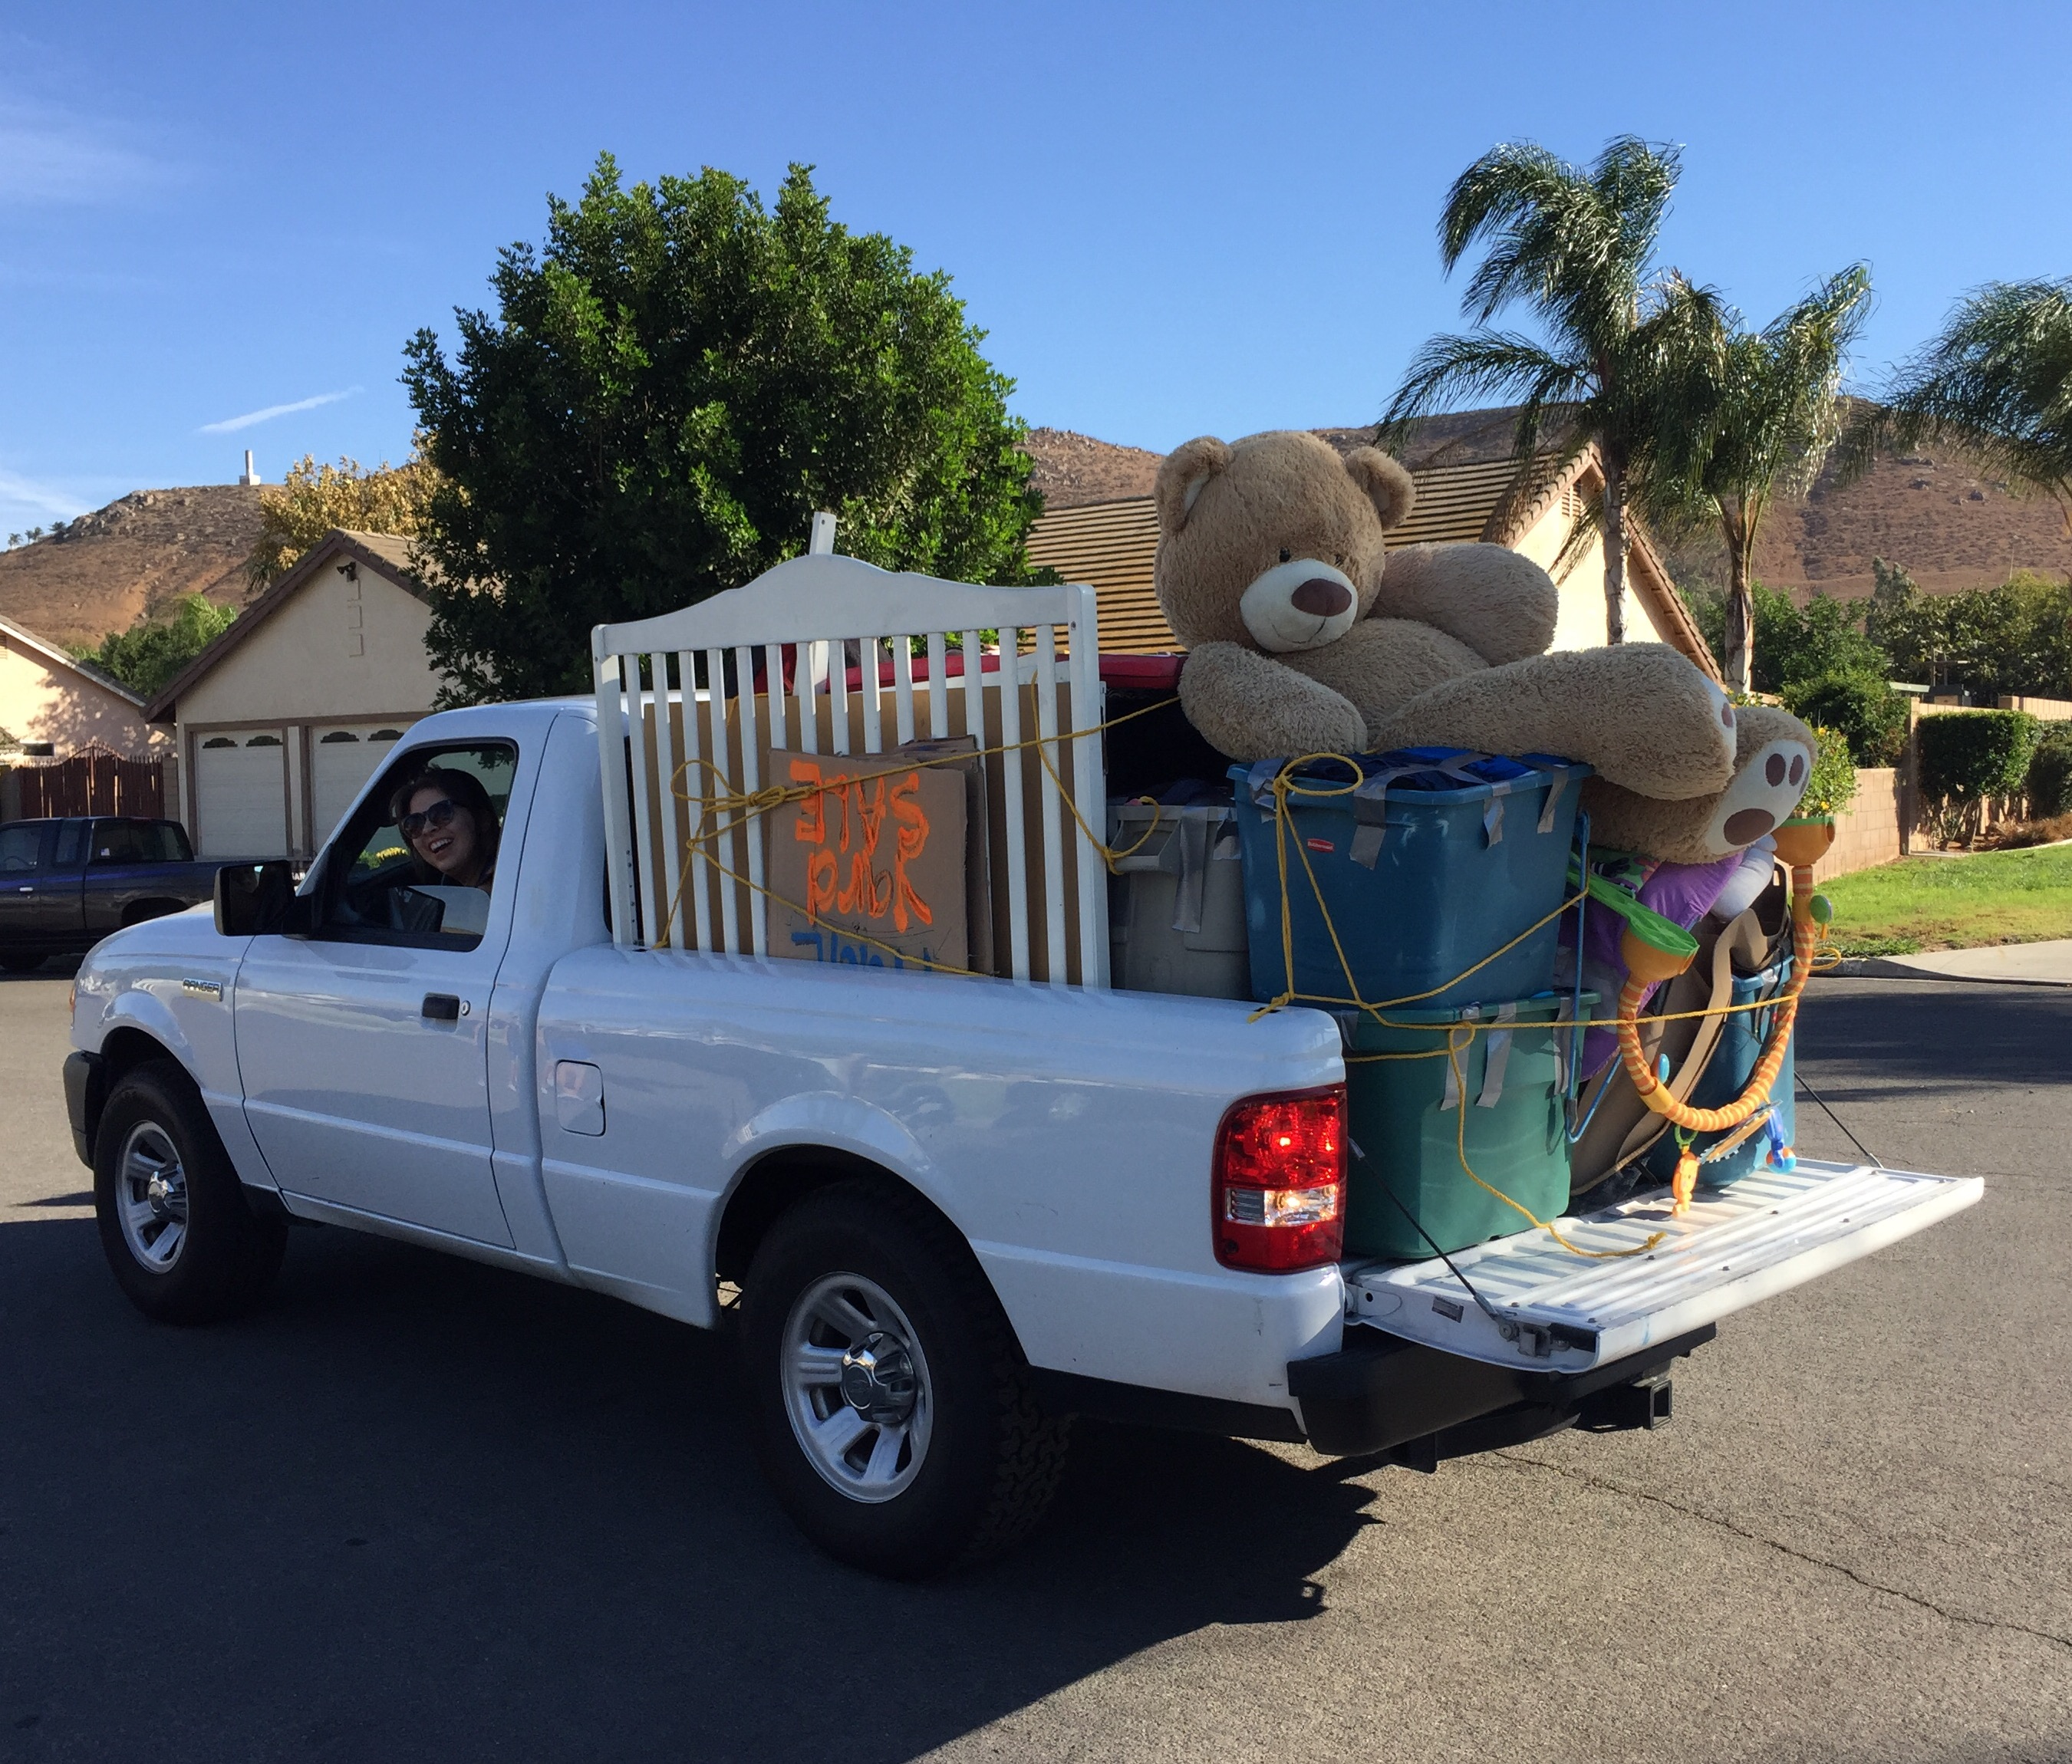
Christina: $1500 2-day yard sale
“Even with Financial aid and scholarships, I knew that I still needed to save money. So, being that I have a lot of friends and family, I asked them if they could donate any of their old stuff so that I could have a HUGE yard sale. My family asked their friends and their neighbors as well. People donated old clothes, shoes, books, toys, furniture, etc. I also sold and made drinks like horchata and jamaica to sell at the yard sale since it was a hot day. During the yard sale I also had signs up that promoted that the funds were going towards my study abroad experience and more people wanted to help. I ended up raising over $1500.”
“I also sold candy bars at work and saved as much as I could with part-time hours. I didn’t go out as much and cut back on the fast food. I also did side jobs like babysit and clean peoples’ houses.”
Christina Sandoval, Chaffey College, Barcelona Spring 2017

Slide 21
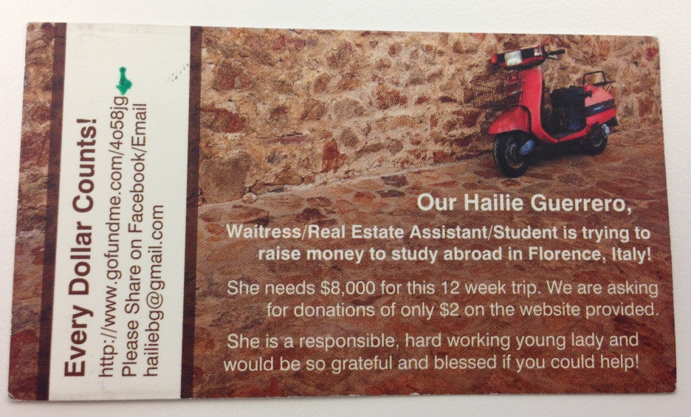
Hallie: A Fundraising Success Story
Hallie made $1,000 with this card! Mainly from perfect strangers who donated.
Her secret? She only asked people for $2 and she gave it to everyone she met.

Slide 22
Advice for managing your money while abroad
Recommended Credit Cards and Debit Cards:
Chase Sapphire Preferred No annual fee in the first year, then $95 / yr. Sign-up bonus is 50,000 points, worth $500 cash or miles for a few domestic roundtrips.
Capital One Venture One has an annual fee, another one does not. Sign up bonuses. Again, no foreign transaction fees. Use points for all kinds of things.
A bank ATM card they might want is the Charles Schwab Bank No foreign transaction fee and it reimburses any ATM fee charged by the bank hosting the ATM. If the Pound is $1.29. Your account is charged $129 when you withdraw 100 Pounds.

