Slide 1
Study Abroad in Florence, Italy
Spring Semester 2018 February 23 - May 19, 2018
NOCCCD Fullerton college & Cypress College

Slide 2
Why study abroad?
Less than 10% of US college students study abroad
Shows college admissions and employers skills such as global awareness, cultural awareness, diversity, problem solving, “thinking out of the box”…
Personal skills you gain: independence, creativity, initiative, adaptability, a sense of humor, flexibility, values, patience…
85% of students agree that studying abroad was the most meaningful experience of their undergraduate education.

Slide 3
Study abroad statistics
Source: www.studyabroad.ucmerced.edu/study-abroad-statistics
100% greater improvement in GPA post study abroad
97% of study abroad students found a job within 12 months of graduation vs. 47% of college graduates found employment in the same period.
25% higher salaries: that’s how much more study abroad students earn than those college graduates who did not study abroad. That averages around $7000 per year
90% of study abroad alumni who applied got into their 1st or 2nd choice of grad schools.

Slide 4
Why Florence?

Slide 5
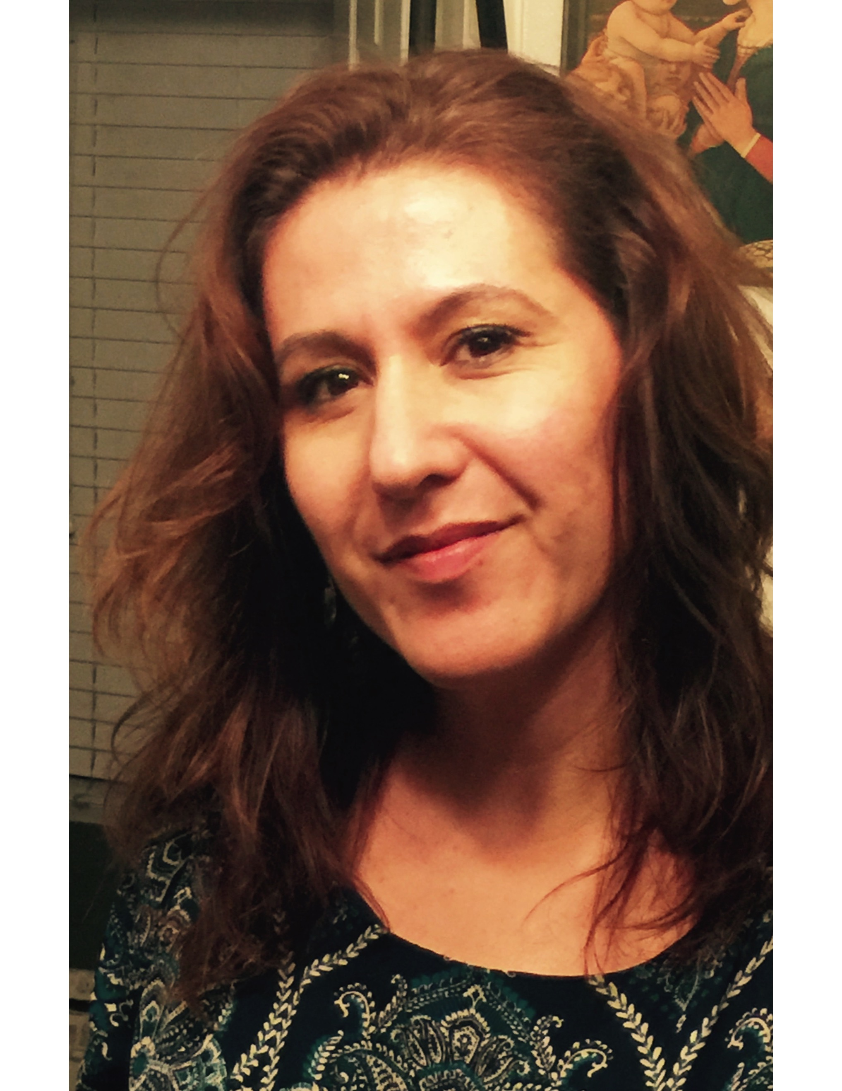
Faculty
Jaime Perez
Art History Professor
Jperez@fullcoll.edu
M. Leonor Cadena
Anthropology Professor
Mcadena@fullcoll.edu

Slide 6
Academics
Courses fulfill several requirements for CSU and IGETC
Held Monday to Thursday
Italian Conversation course taught by local instructors
Florence is our classroom!
ART 110 F: Introduction to Art
ART 112 F: Ancient to Medieval Art
ART 113 F: Renaissance to Modern Art
ART/MUS/THEA 196HF: Honors Creative Arts (*students take only one of these courses)
ANTH 101 F/HF: Physical/Biological Anthropology
ANTH 102 F/HF: Cultural Anthropology
ANTH 103 F: Archaeology
ANTH 107 F: Anthropology of Magic, Witchcraft, and Religion
INDS 298F: Interdisciplinary Studies Seminar for Study Abroad

Slide 7
Founded in 1964, AIFS is a leader in providing study abroad programs for US college students
Over 1.5 million students have studied abroad with AIFS
Onsite coordinators set up and run the program
Extensive incident response and crisis management plan

Slide 8
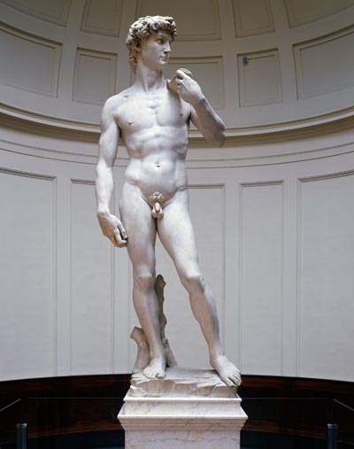
Orientation & AIFS Services
Orientation program:
Orientation meeting with information packet & local area info
Welcome reception
Half-day walking tour of Florence
Workshops on cultural differences & life in Florence
AIFS student center with AIFS Program Coordinator & Student Advisors for information, personal advising & counseling and 24-hour emergency contact service
Notes:
We are situated in Bloomsbury, which is home to several universities, colleges and academics in general. It’s studious, calm and pleasant. It’s also in a fantastic location; British Museum two minute walk, British Library ten minute walk, China town a ten minute walk, Oxford Street ten minute walk, Covent Garden ten minute walk, Kings Cross (gateway to England and Europe) fifteen minute walk.
We are also opposite the University of London Union (Student Central) where you’ll have some of your classes and access to clubs and societies.

Slide 9
Center of Florence
Study Center

Slide 10
Housing
Student Apartments
Located in the historical center of Florence (30 minutes walking distance or less)
Typically 4-6 students in each apartment in double rooms
Equipped kitchens, living area, full bath, Wi-Fi, washing machines
No meals are included
Homestay with a local family
Located within a 30 minutes walking distance or less
Two in each apartment in double rooms
Wi-Fi provided
Includes breakfast daily and 5 dinners per week
Supplemental fee $795

Slide 11
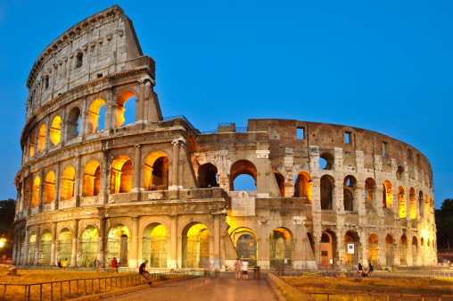
3 day, 2 night excursion to Rome
Included:
3 days/2 nights
Transportation & accommodations in tourist class hotel & breakfast daily
Entrances to the Colosseum & Roman Forum
Guided tour of the Vatican Museums & the Sistine Chapel
Metro tickets and one group dinner

Slide 12
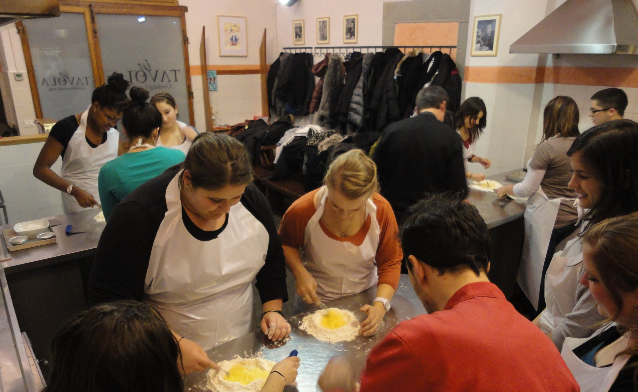
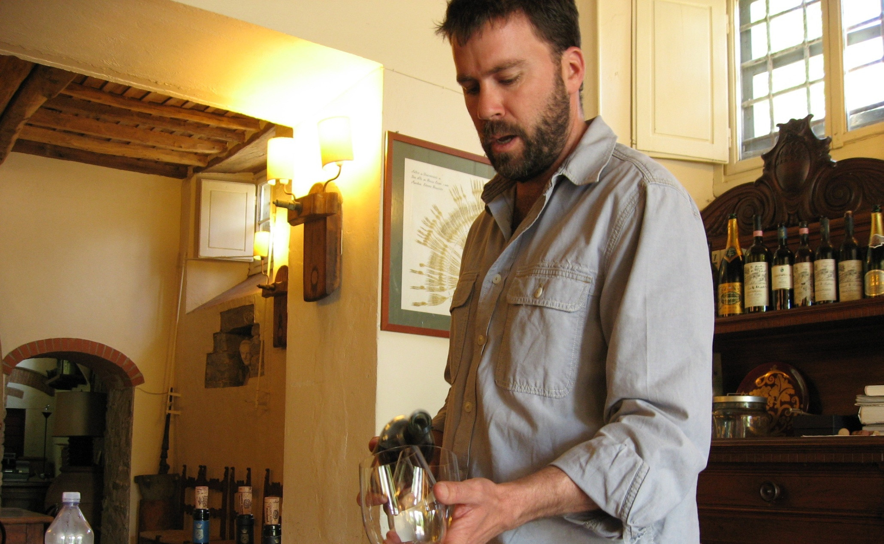
Cultural Activities & Excursions
Included in the program fee:
Entrances and guided tours of the Uffizi Gallery, San Marco, the Duomo complex, Accademia Gallery, Pitti Palace
Wine tasting lectures & Italian cooking classes
An evening ballet performance
Entrances to a soccer match
Themed walking tours & film nights

Slide 13
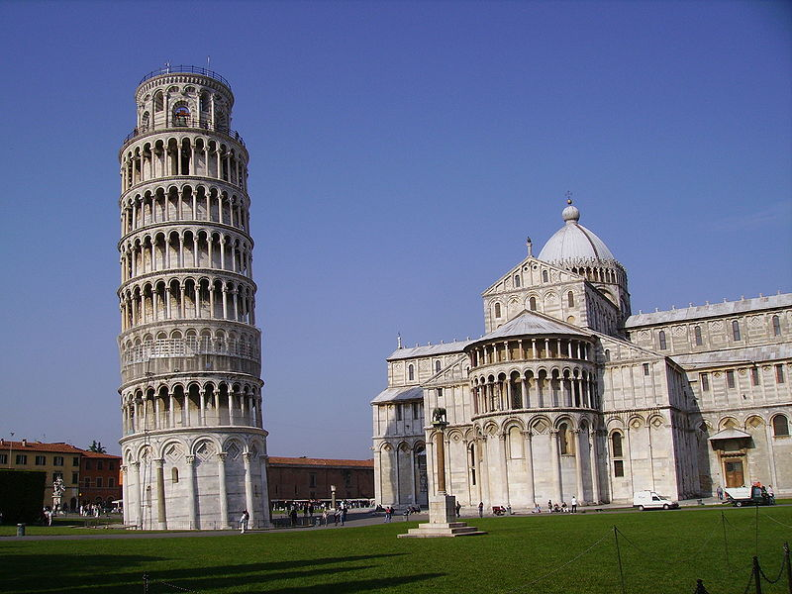
Day excursions to Siena and to Pisa

Slide 14
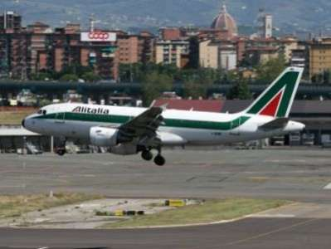
Round trip flights
Included in the program fee, round trip airfare from LAX to Florence (FLR) including airport pick-up and return
$645* airline imposed taxes, fees and fuel surcharges will be bill separately
*subject to change

Slide 15
Program fee & summary of what is included…
$8055 (30-34 students), $7945 (35-39 students), $7845 (40-44 students), $7745 (45 or more students)
Round-trip airfare from LA to Florence including airport transfers; *excluding taxes & surcharges
Student Apartments or Homestays* (*additional fee)
AIFS Student Center & Staff services including 24/7 emergency contact
3 day/2 night excursion to Rome and two one-day excursion to Siena & Pisa
Orientation program & activities, Guided tour of Florence
Activities in Florence including visits to museums, monuments, wine tasting and cooking class, walking tours, ballet and a sporting event
Medical and Fee refund insurance
Application fee
Pre departure services and orientation

Slide 16
Expenses not included
Community College tuition fees (BOG Fee Waiver applicable)
Textbooks
Personal expenses including passport fees and personal travel, laundry
Mandatory additional government and airline imposed departure taxes, fees and fuel charges of $645 (*subject to change)
$250 refundable damage deposit
Meals (Homestays include breakfast daily)
Optional Excursions to Venice and Sorrento & Pompeii
Optional Meal plan

Slide 17
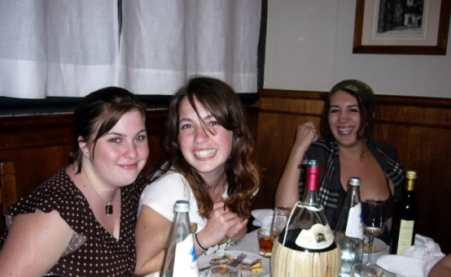
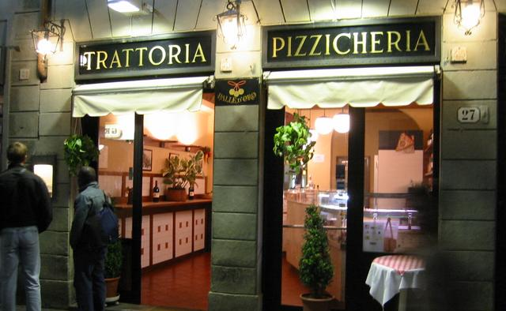
Optional Meal Plan $475
30 vouchers
Valid for lunch or dinner in local trattorias and ristorantes, usually including 2 courses plus drink and dessert

Slide 18
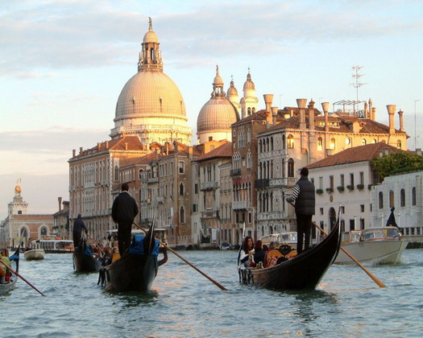
3 day, 2 night excursion to Venice $575
Included:
3 days/2 nights
Transportation by train & accommodations in tourist class hotel & breakfast daily
Guided walking tour of Venice including St. Mark’s Square and the Bridge of Sighs
Combined entrance ticket to the Doge’s Palace, Correr Museum, Venice National Archeological museum, Marciana National Library
Vaporetto pass and one group meal
AIFS Tour Manager

Slide 19
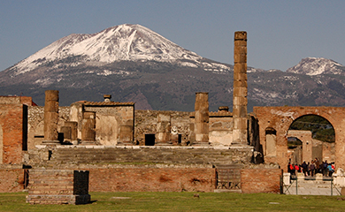
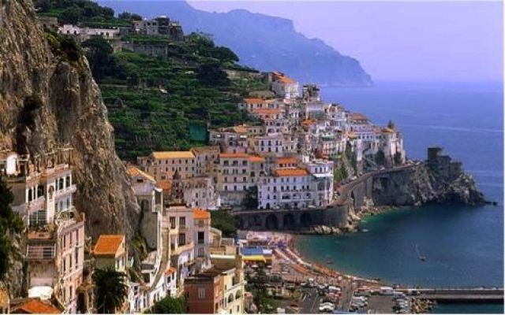
3 day, 3 night excursion to Pompeii & Sorrento $495
Included:
3 days/3 nights
Transportation by train & bus
Accommodations in tourist class hotel & breakfast daily and one group dinner
Guided walking tour of Pompeii and visit to Mount Vesuvius
Day excursion to Capri with island bus day travel pass for island exploration
AIFS Tour Manager

Slide 20
Eligibility requirements
Applicant must be 18 years or older.
Completion of at least 12 units of degree applicable college credit
GPA of 2.5 or higher
A grade of C or better in English 100 completed by the Spring 2017 semester.

Slide 21
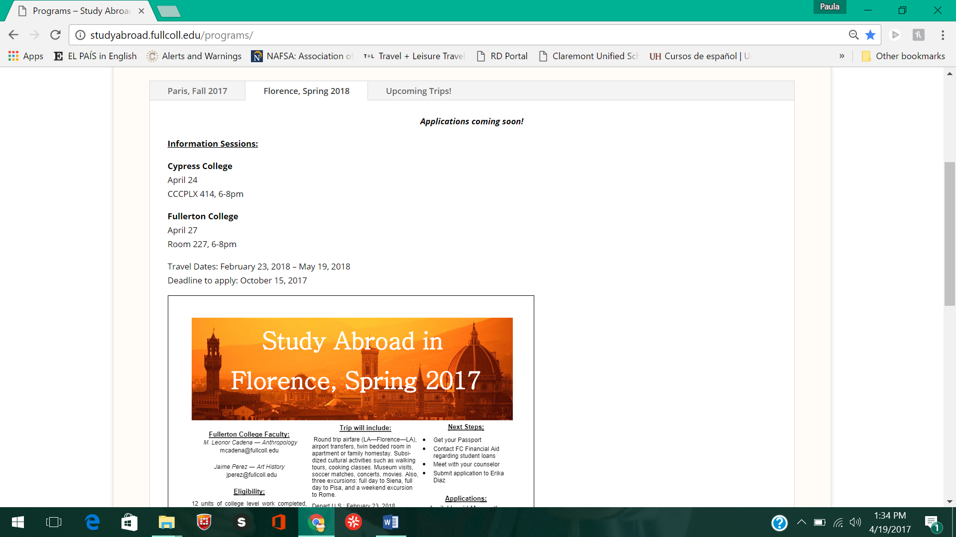
Apply now!
DEADLINE to APPLY
October 15
http://studyabroad.fullcoll.edu/apply/forms/

Slide 22
Financial Aid
Fullerton College Financial Aid Office (For both Fullerton College & Cypress College students)
Building 100, First Floor. Tel. (714) 992-7091
GI Bill Information
The Veteran’s Resource Center, Room 518, Tel (714) 992-7102

Slide 23
Scholarships
Benjamin Gilman Scholarship www.gilmanscholarship.org *For Pell Grant eligible students
Fullerton College or Cypress College Foundation Scholarships
California Community Colleges for International Education www.ccieworld.org
www.studyabroad.com/study-abroad-scholarships
www.studyabroadfunding.org
www.studentscholarships.org
www.internationalscholarships.com
IMPORTANT!! Most scholarship deadlines are generally in the early Fall! APPLY SOON!

Slide 24
Funding ideas
Back to basics ideas- side jobs, sales, garage sales, etc.
Lifestyle changes- cut down on expenses, gifts of money
Crowd funding- www.gofundme.com, etc.
Letter writing campaigns

Slide 25
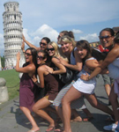
For more information
See the Fullerton College Study Abroad website
http://studyabroad.fullcoll.edu
Or contact:
Doug Eisner deisner@fullcoll.edu (714) 992-7308
Erika Diaz ediaz@fullcoll.edu (714) 732-5688 *Applications should be delivered to Erika at Fullerton College, room 823.

