Slide 1

Study Literature, Film, and Psychology in Paris!
Study Abroad in Fall 2017
Departs: September 17, 2017
Returns: December 8, 2017
Program Information: Pending NOCCCD Board Approval

Slide 2

Why should you go on a Study Abroad trip?
Community college students who go on study abroad trips transfer faster than students who don’t go
Students who go on study abroad trips finish their Bachelor’s Degrees faster than students who don’t go
Students who go on study abroad trips report that they enjoyed college more than students who didn’t go
Employers report that they want new employees with some international experience.
Get out of the OC! You have your weekends off, and you can travel cheaply all over Europe.

Slide 3
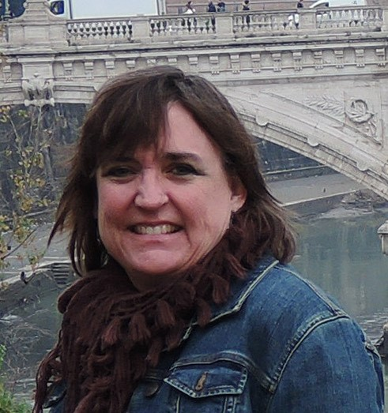
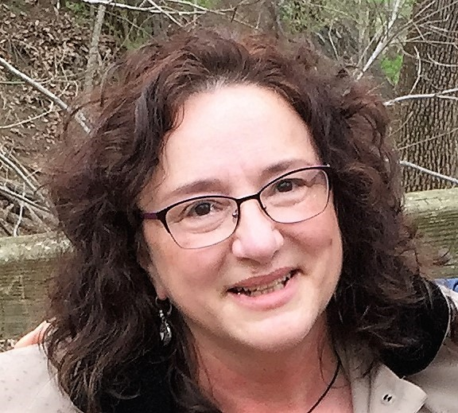
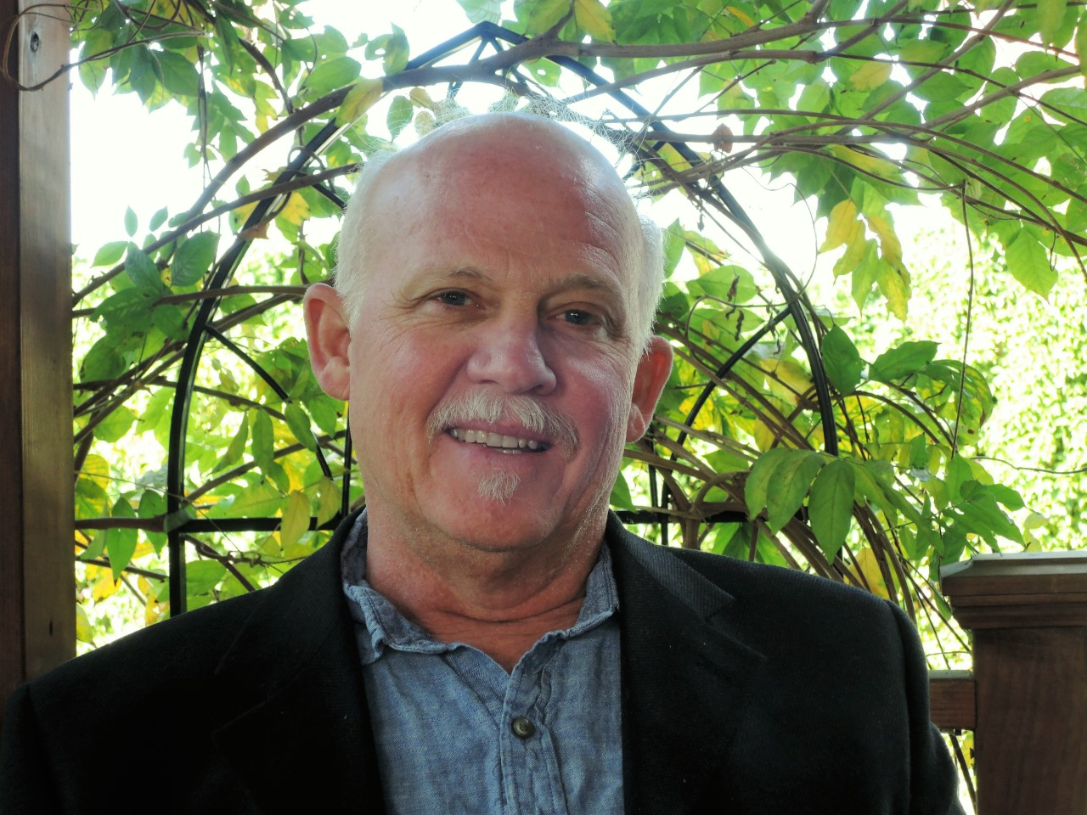
Faculty
Jeanne Costello
English Professor
jcostello@fullcoll.edu
Phil Mayfield
English Professor
pmayfield@fullcoll.edu
Callista Lee
Psychology Professor
clee@fullcoll.edu

Slide 4
Courses Offered
English 102F/HF: Introduction to Literature*
English 103F/HF: Critical Reasoning and Writing*
English 105F: Creative Writing
English 208F: Introduction to Film Studies
PSY 120F: Human Sexuality
PSY 131F: Cross Cultural Psychology
PSY 233F: Psychology of Adjustment
All credits transferrable to Cal States and/or UCs. *Honors Section available

Slide 5
Cost of Program: approximately $8900
Includes:
Airfare (Los Angeles – Paris – Los Angeles)
Transfer to assigned housing
Housing – Twin-bedded room in a home stay with a French family, which includes breakfast or an apartment
Subsidized cultural activities such as walking tours, cooking classes, museum visits, soccer matches, concerts, movies
Metro Pass in Paris
Excursions on Next Slide
Additional Charges: Plus airline taxes and fuel charges (approximately $690), tuition, textbooks, class costs, traveler’s insurance & miscellaneous expenses
Excursions and price subject to change

Slide 6



Excursions
Weekend excursion to Provence
Full-day excursion to Chartres
Full-day excursion to Versailles

Slide 7
Financial Aid
Available for Study Abroad
Contact:
FC Financial Aid Office
In Person: Building 100, First Floor
By Phone: (714) 992-7091
Note: All Financial Aid for our Study Abroad Programs comes from Fullerton College
G.I. Bill Information, contact:
The Veterans’ Resource Center
In Person: FC/Room 518
By Phone: (714) 992-7102

Slide 8

Future Programs!
Spring 2018: Florence, Italy: Courses in Anthropology and Art History
Summer 2018: Madrid, Spain: Psychology 101
Fall 2018: Barcelona, Spain: Courses in Business and English

Slide 9
Questions?
See the Study Abroad Website:
http://studyabroad.fullcoll.edu
or Contact:
Doug Eisner
deisner@fullcoll.edu
714-992-7308
or
Erika Diaz
ediaz@fullcoll.edu
714-732-5688
* Deliver application to Erika Diaz, Fullerton College Room 823

